Slide 1
CompTIA Security+ Guide to Network Security Fundamentals, Sixth Edition
Chapter 4
Advanced Cryptography and P K I

Slide 2
Objectives
4.1 Explain how to implement cryptography
4.2 Define digital certificates
4.3 Describe the components of Public Key Infrastructure (P K I)
4.4 Describe the different transport encryption protocols

Slide 3
Implementing Cryptography
Cryptography that is improperly applied can lead to vulnerabilities
It is essential to understand the different options that relate to cryptography
Implementing cryptography includes understanding:
Key strength
Secret algorithms
Block cipher modes of operation
Cryptographic service providers
The use of algorithm input values

Slide 4
Key Strength (1 of 2)
Cryptographic key
A value that serves as input to an algorithm
Transforms plaintext into ciphertext (and vice versa for decryption)
Three primary characteristics that determine the resiliency of the key to attacks (called key strength)
Randomness
Length of the key
Cryptoperiod – length of time for which a key is authorized for use

Slide 5
Key Strength (2 of 2)
Key length | Key space | Average number of attempts needed to break
3 | 17,576 | 8788
4 | 456,976 | 228,488
5 | 11,881,376 | 5,940,688
6 | 308,915,776 | 154,457,888
7 | 8,031,810,176 | 4,015,905,088
8 | 208,827,064,576 | 104,413,532,288

Slide 6
Secret Algorithms
Would a secret algorithm enhance security in the same way as keeping a key or password secret?
No
For a cryptography to be useful it needs to be widespread:
A military force that uses cryptography must allow many users to know of its existence to use it

Slide 7
Block Cipher Modes of Operation
A block cipher manipulates an entire block of plaintext at one time
The plaintext is divided into separate blocks of specific lengths
Each block is encrypted independently
Block cipher mode of operation
Specifies how block ciphers should handle these blocks
Most common modes:
Electronic Code Book (E C B)
Cipher Block Chaining (C B C)
Counter (C T R)
Galois/Counter (G C M)

Slide 8
Crypto Service Providers (1 of 2)
Crypto service provider
Allows an application to implement an encryption algorithm for execution
Crypto service providers typically:
Implement cryptographic algorithms
Generate keys
Provide key storage
Authenticate users by calling various crypto modules to perform specific tasks
Crypto service providers can be implemented in:
Software, hardware, or both

Slide 9
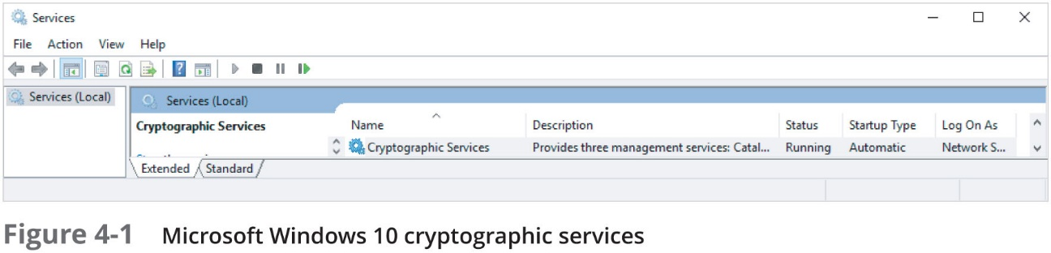
Crypto Service Providers (2 of 2)

Slide 10
Algorithm Input Values
Some cryptographic algorithms require that in addition to a key another value can or must be input
May be called algorithm input values
Salt
A value that can be used to ensure that plaintext, when hashed, will not consistently result in the same digest
Most often used in password-based systems
Nonce
An input value that must be unique within some specified scope
Initialization vector (I V)
Most widely used algorithm input

Slide 11
Digital Certificates
Digital Certificates
A common application of cryptography
Using digital certificates involves
Understanding their purpose
Knowing how they are managed
Determining which type of digital certificate is appropriate for different situations

Slide 12
Defining Digital Certificates (1 of 3)
Digital signature
Used to prove a document originated from a valid sender
Weakness of using digital signatures
They only show that the private key of the sender was used to encrypt the digital signature
Imposter could post a public key under a sender’s name

Slide 13
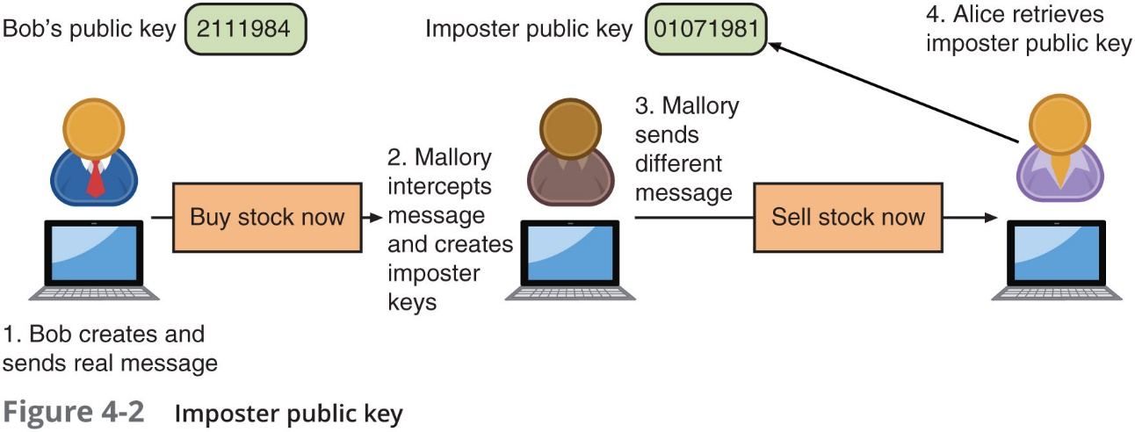
Defining Digital Certificates (2 of 3)

Slide 14
Defining Digital Certificates (3 of 3)
Trusted third party
Used to help solve the problem of verifying identity
Verifies the owner and that the public key belongs to that owner
Helps prevent man-in-the-middle attack that impersonates owner of public key
A digital certificate is a technology used to associate a user’s identity to a public key
That has been “digitally signed” by a trusted third party

Slide 15
Managing Digital Certificates
Several entities and technologies are used to manage digital certificates:
Certificate authorities (C A s)
Tools for managing certificates

Slide 16
Certificate Authorities (1 of 3)
Certificate authority (C A)
Responsible for digital certificates
May also be called root C A
If a user wants a digital certificate:
After generating a public and private key, user must complete a request with information such as name, address, email address, etc.
Known as a Certificate Signing Request (C S R)
User electronically signs the C S R and sends it to an intermediate C A
Intermediate C A processes the C S R and verifies the authenticity of the user

Slide 17
Certificate Authorities (2 of 3)
Car title scenario | Digital certificate element | Explanation
Car title application | Certificate Signing Request (C S R) | Formal request for digital certificate
Sign car title application | Create and affix public key to certificate | Added to digital certificate for security
Visit county courthouse | Intermediate certificate authority | Party that can process C S R on behalf of C A
Title sent from state D M V | Certificate authority (C A) | Party responsible for digital certificates

Slide 18
Certificate Authorities (3 of 3)
Intermediate C A s are subordinate entities designed to handle specific CA tasks such as:
Processing certificate requests
Verifying the identity of the individual
The person requesting a digital certificate can be authenticated by:
Email, documents, in person
A common method to ensure security and integrity of a root C A:
Keep it in an offline state from the network (offline C A)
It is only brought online (online C A) when needed for specific and infrequent tasks

Slide 19
Certificate Management (1 of 4)
Certificate Repository (C R)
Publicly accessible centralized directory of digital certificates
Can be used to view certificate status
Can be managed locally by setting it up as a storage area connected to the C A server
Certificate Revocation
Lists of digital certificate that have been revoked
Reasons a certificate would be revoked
Certificate is no longer used
Details of the certificate have changed, such as user’s address
Private key has been lost or exposed (or suspected lost or exposed)
Certificate Revocation List (C R L)
A list of certificate serial numbers that have been revoked

Slide 20
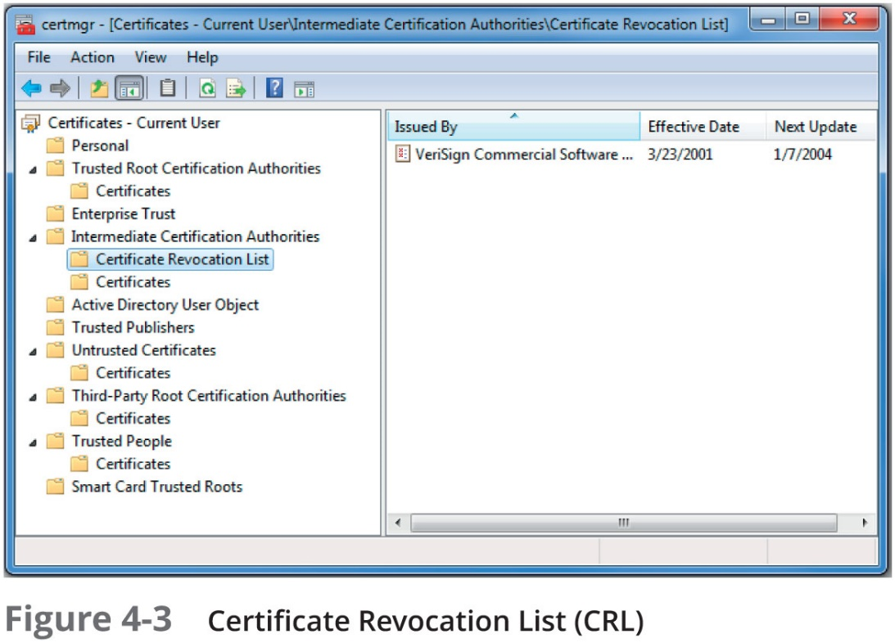
Certificate Management (2 of 4)

Slide 21
Certificate Management (3 of 4)
Online Certificate Status Protocol (O C S P)
Performs a real-time lookup of a certificate’s status
Called a request-response protocol
The browser sends the certificate’s information to a trusted entity known as an O C S P Responder
The O C S P Responder provides immediate revocation information on that certificate
O C S P stapling
A variation of O C S P where web servers send queries to the O C S P Responder server at regular intervals to receive a signed time-stamped response

Slide 22
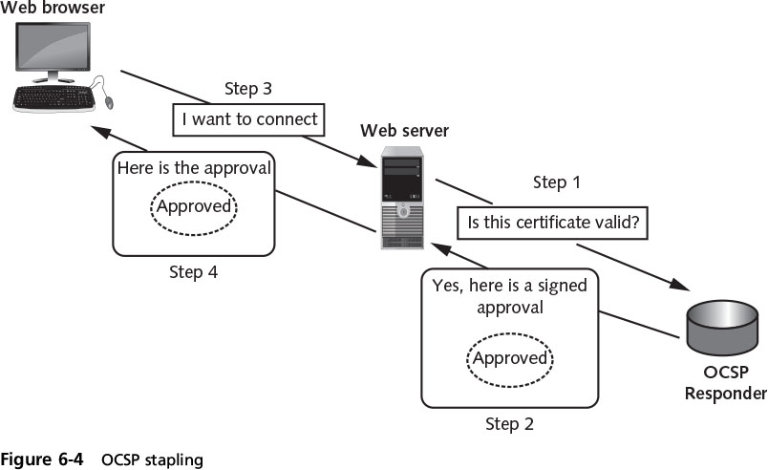
Certificate Management (4 of 4)

Slide 23
Types of Digital Certificates
Different categories of digital certificates
The most common categories are:
Root certificates
Domain certificates
Hardware and software certificates

Slide 24
Root Digital Certificates (1 of 4)
The process of verifying a digital certificate is genuine depends upon certificate chaining
Links several certificates together to establish trust between all the certificates involved
Endpoint of the chain is the user digital certificate itself
The beginning point of the chain is known as a root digital certificate
Created and verified by a C A
Self-signed and do not depend upon any higher-level authority
Between root digital certificate and the user certificate can be
One or more intermediate certificates issued by intermediate C A s

Slide 25
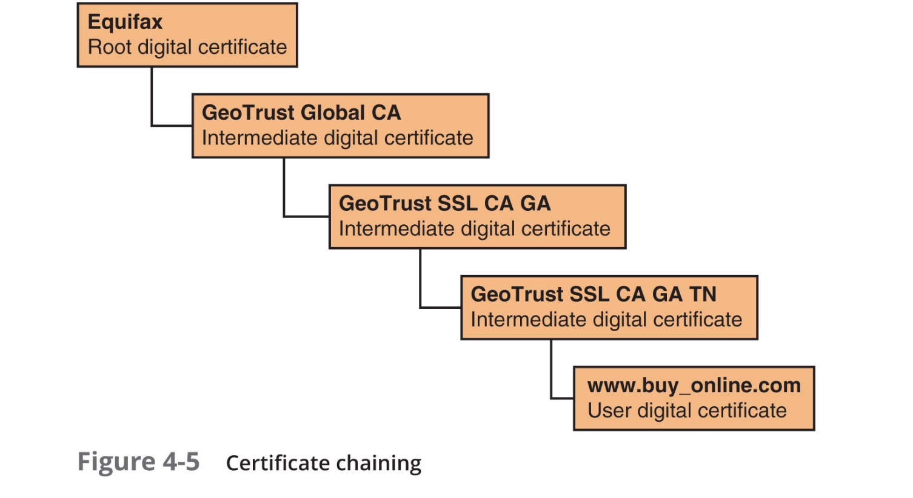
Root Digital Certificates (2 of 4)

Slide 26
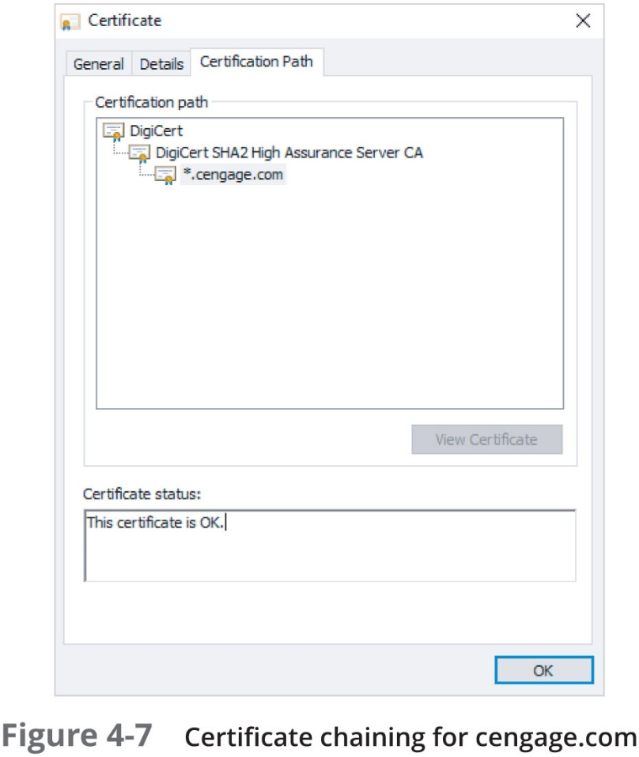
Root Digital Certificates (3 of 4)

Slide 27
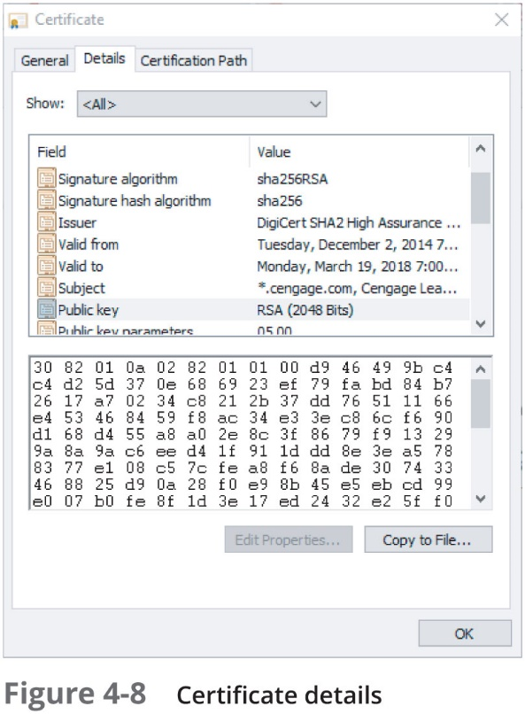
Root Digital Certificates (4 of 4)

Slide 28
Domain Digital Certificates (1 of 5)
Most digital certificates are web server digital certificates issued from a web server to a client
Web server digital certificates perform two primary functions:
Ensure the authenticity of the web server to the client
Ensure the authenticity of the cryptographic connection to the web server
Several types of domain digital certificates:
Domain validation digital certificates
Extended validation digital certificates
Wildcard digital certificates
Subject alternative names digital certificates

Slide 29
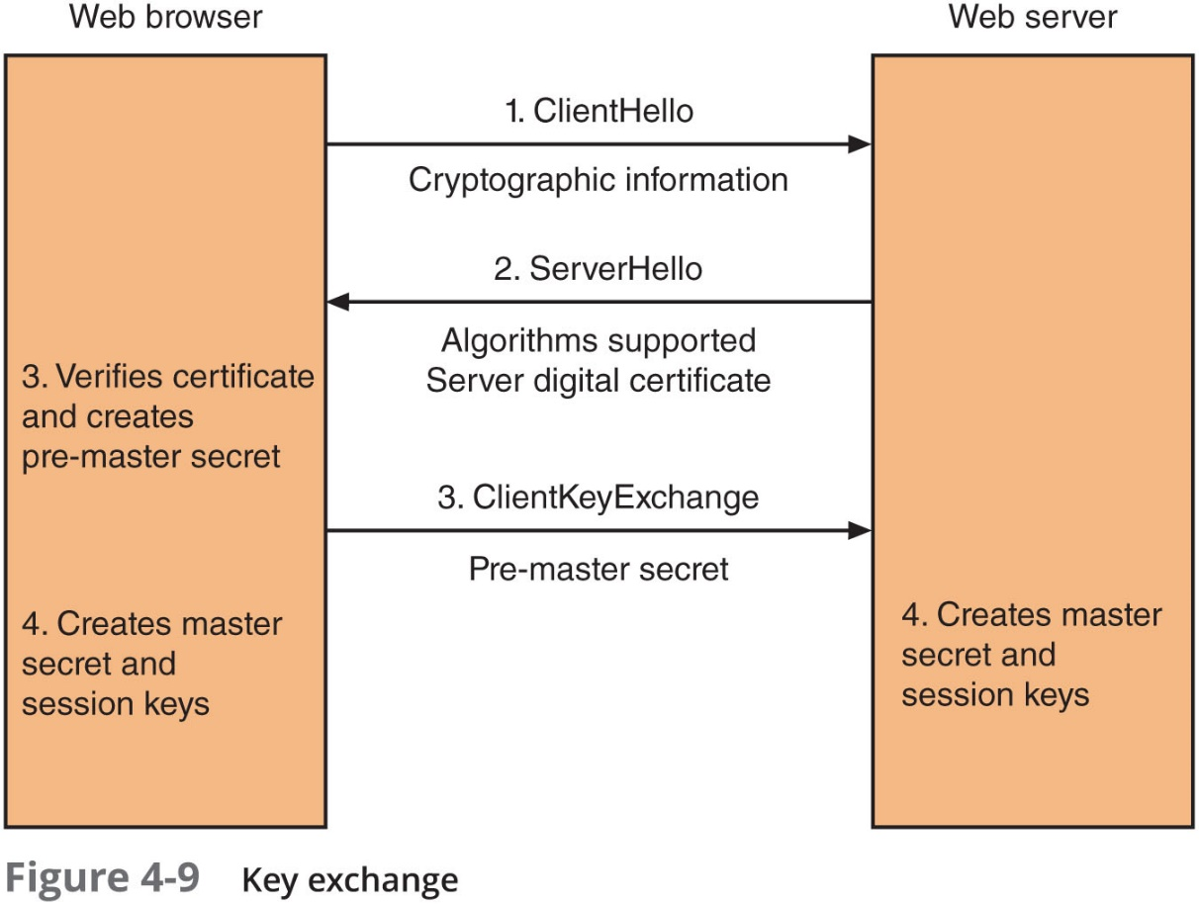
Domain Digital Certificates (2 of 5)

Slide 30
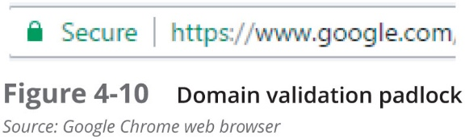
Domain Digital Certificates (3 of 5)
Domain validation digital certificate
Verifies the identify of the entity that has control over the domain name

Slide 31
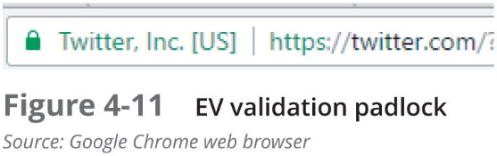
Domain Digital Certificates (4 of 5)
Extended Validation (E V)
This type of certificate requires more extensive verification of the legitimacy of the business

Slide 32
Domain Digital Certificates (5 of 5)
Wildcard digital certificate
Used to validate a main domain along with all subdomains
Subject Alternative Name (S A N) digital certificate
Also known as a Unified Communications Certificate (U C C)
Primarily used for Microsoft Exchange servers or unified communications
Hardware and Software digital certificates
Machine digital certificate
Code signing digital certificate
Email digital certificate

Slide 33
Digital Certificate Formats
The most widely accepted digital certificates are defined by a division of the I T U
Known as the Telecommunication Standardization Sector (I T U-T)
Adhere to the x.509 standard
All x.509 certificates follow the standard I T U-T x.690, which specifies one of three encoding formats:
Basic Encoding Rules (B E R)
Canonical Encoding Rules (C E R)
Distinguished Encoding Rules (D E R)

Slide 34
Public Key Infrastructure (P K I)
Important management tool for the use of:
Digital certificates:
Asymmetric cryptography
Important to understand P K I
How it is managed
How key management is performed
Know P K I trust models

Slide 35
What is Public Key Infrastructure (P K I)?
There is a need for a consistent means to manage digital certificates
Public key infrastructure (P K I) - a framework for all entities involved in digital certificates
Certificate management actions facilitated by P K I
Create
Store
Distribute
Revoke

Slide 36
Trust Models
Trust
Confidence in or reliance on another person or entity
Trust model
Refers to the type of trust relationship that can exist between individuals and entities
Direct trust
A type of trust model where one person knows the other person
Third-party trust
Two individuals trust each other because each trusts a third party

Slide 37
Hierarchical Trust Model (1 of 2)
Hierarchical Trust Model
Assigns a single hierarchy with one master C A called the root
The root signs all digital certificate authorities with a single key
Can be used in an organization where one C A is responsible for only that organization’s digital certificates
Hierarchical trust model limitations:
A single C A private key may be compromised rendering all certificates worthless
Having a single C A who must verify and sign all digital certificates may create a significant backlog

Slide 38
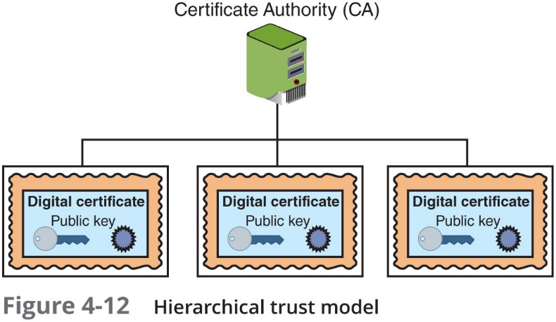
Hierarchical Trust Model (2 of 2)

Slide 39
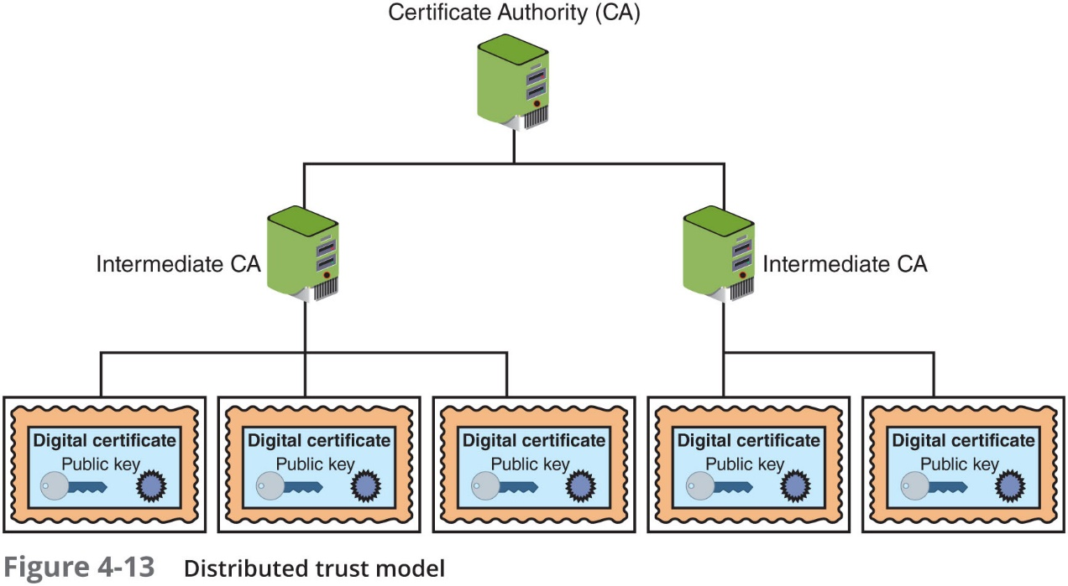
Distributed Trust Model
Distributed Trust Model
Multiple C A s sign digital certificates
Eliminates limitations of hierarchical trust model

Slide 40
Bridge Trust Model (1 of 2)
Bridge Trust Model
One C A acts as facilitator to interconnect connect all other C A s
Facilitator C A does not issue digital certificates, instead it acts as hub between hierarchical and distributed trust model
Allows the different models to be linked

Slide 41
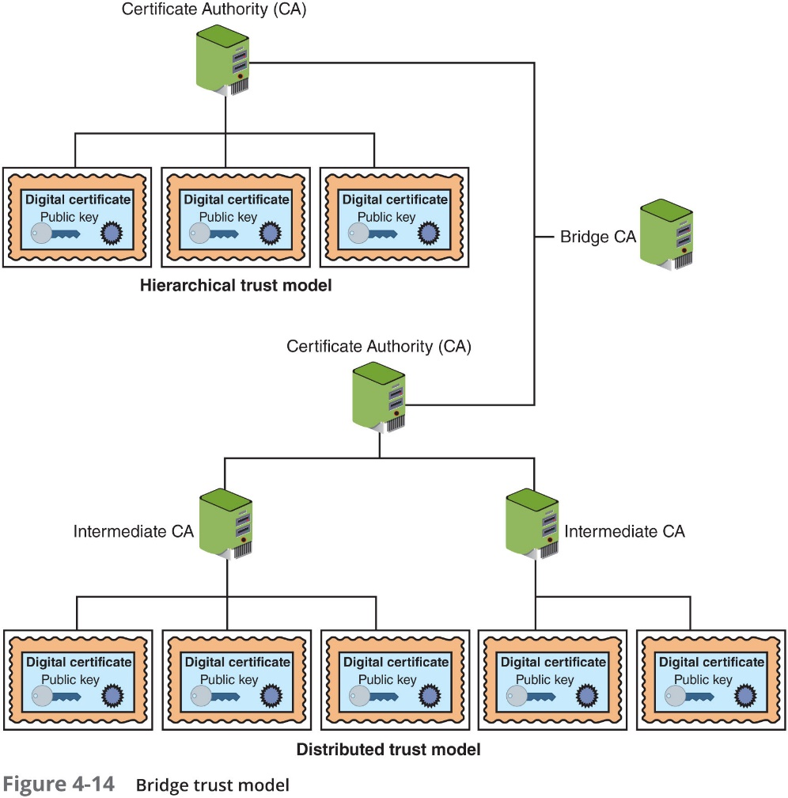
Bridge Trust Model (2 of 2)

Slide 42
Managing P K I (1 of 2)
Certificate Policy (C P)
A published set of rules that govern operation of a P K I
Provides recommended baseline security requirements for the use and operation of C A, R A, and other P K I components
Certificate Practice Statement (C P S)
A technical document that describes in detail how the C A uses and manages certificates
Also covers how to register for a digital certificate, how to issue them, when to revoke them, procedural controls and key pair management

Slide 43
Managing P K I (2 of 2)
Certificate life cycle
Creation
Occurs after user is positively identified
Suspension
May occur when employee on leave of absence
Revocation
Certificate no longer valid
Expiration
Key can no longer be used

Slide 44
Key Management
Key Management includes:
Key storage
Key usage
Key handling procedures

Slide 45
Key Storage
Means of public key storage
Embedding within digital certificates
Means of private key storage
Stored on user’s local system
Software-based storage may expose keys to attackers
Alternative: storing keys in hardware
Smart-cards
Tokens

Slide 46
Key Usage
Multiple pairs of dual keys can be created
If more security is needed than a single set of public/private keys
One pair used to encrypt information
Public key backed up in another location
Second pair used only for digital signatures
Public key in that pair would never be backed up

Slide 47
Key Handling Procedures (1 of 3)
Key escrow
Keys are managed by a third party, such as a trusted C A
Private key is split and each half is encrypted
Two halves sent to third party, which stores each half in separate location
User can retrieve and combine two halves and use this new copy of private key for decryption
Expiration
Keys expire after a set period of time
Renewal
Existing key can be renewed

Slide 48
Key Handling Procedures (2 of 3)
Revocation
Keys may be revoked prior to its expiration date
Revoked keys may not be reinstated
Recovery
Need to recover keys of an employee hospitalized for extended period
Key recovery agent (K R A) may be used
Group of people may be used (M-of-N control)
Suspension
Suspended for a set period of time and then reinstated
Destruction
Removes all public and private keys and user’s identification from the C A

Slide 49
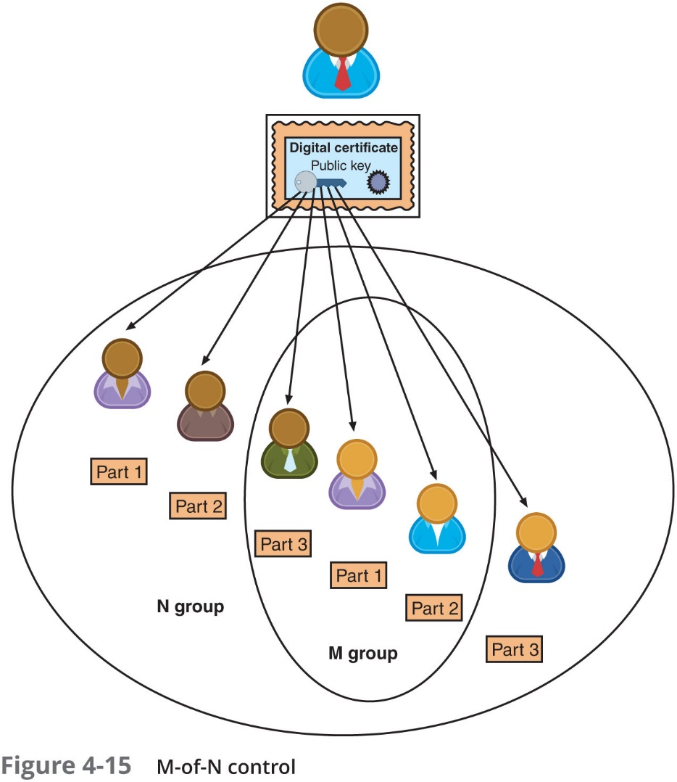
Key Handling Procedures (3 of 3)

Slide 50
Cryptographic Transport Protocols
Most common cryptographic transport algorithms:
Secure Sockets Layer
Transport Layer Security
Secure Shell
Hypertext Transport Protocol Secure
S/MIME
Secure Real-time Transport Protocol
I P Security

Slide 51
Secure Sockets Layer (S S L)
Secure Sockets Layer (S S L)
One of the most common transport algorithms
Developed by Netscape
Design goal was to create an encrypted data path between a client and a server
Uses the Advanced Encryption Standard (A E S)
S S L version 3.0 is the current version

Slide 52
Transport Layer Security (T L S)
Transport Layer Security (T L S)
S S L v3.0 served as the basis for T L S v1.0
Versions starting with v1.1 are significantly more secure than S S L v3.0
Current version is T L S v1.2
Cipher suite
A named combination of the encryption, authentication, and message authentication code (M A C) algorithms that are used with S S L and T L S
Length of keys - a factor in determining the overall security of a transmission
Keys of less than 2048 bits are considered weak
Keys of 2048 bits are considered good
Keys of 4096 bits are strong

Slide 53
Secure Shell (S S H)
An encrypted alternative to the Telnet protocol used to access remote computers
It is a Linux/UNIX-based command interface and protocol
S S H is a suite of three utilities: slogin, s s h, and s c p
Client and server ends of the connection are authenticated using a digital certificate and passwords are encrypted
Can be used as a tool for secure network backups

Slide 54
Hypertext Transport Protocol Secure (H T T P S)
A common use of T L S and S S L:
To secure Hypertext Transport Protocol (H T T P) communications between browser and Web server
The secure version is actually “plain” H T T P sent over S S L or T L S
Called Hypertext Transport Protocol Secure (H T T P S) and uses port 443 instead of H T T P’s port 80
Users must enter U R L s with h t t p s://

Slide 55
Secure/Multipurpose Internet Mail Extensions (S/M I M E)
Secure/Multipurpose Internet Mail Extensions (S/M I M E)
A protocol for securing email messages
Allows users to send encrypted messages that are also digitally signed

Slide 56
Secure Real-time Transport Protocol (S R T P)
Secure Real-time Transport Protocol (S R T P)
A secure extension protecting transmission using the Real-time Transport Protocol (R T P)
S R T P provides protection for Voice over I P (V o I P) communications
Adds security features such as message authentication and confidentiality for V o I P Communications

Slide 57
I P Security (I P sec)
I P sec is considered to be a transparent security protocol
Transparent to applications, users, and software
I P sec provides three areas of protection that correspond to three I P sec protocols:
Authentication
Confidentiality
Key management
Supports two encryption modes:
Transport - encrypts only the data portion of each packet and leaves the header unencrypted
Tunnel - encrypts both the header and the data portion

Slide 58
Review Questions
Which of the following is NOT a method for strengthening a key?
A. Randomness
B. Cryptoperiod
C. Length
D. Variability
_____ are symmetric keys to encrypt and decrypt information exchanged during the session and to verify its integrity.
A. Encrypted signatures
B. Session keys
C. Digital certificates
D. Digital digests
_____ is a protocol for securely accessing a remote computer.
A. Transport Layer Security (TLS)
B. Secure Shell (SSH)
C. Secure Sockets Layer (SSL)
D. Secure Hypertext Transport Protocol (SHTTP)

Slide 59
Chapter Summary (1 of 2)
Cryptography that is improperly applied can lead to vulnerabilities that will be exploited
A digital certificate is the user’s public key that has been digitally signed by a trusted third party who verifies the owner and that the public key belongs to that owner
A certificate repository (C R) is a list of approved digital certificates
Revoked digital certificates are listed in a Certificate Revocation List (R C L)
Status can also be checked through the Online Certificate Status Protocol (O C S P)
There are several different types of digital certificates

Slide 60
Chapter Summary (2 of 2)
Domain validation digital certificates verify the identity of the entity that has control over the domain name but indicate nothing regarding the trustworthiness of the individuals behind the site
A public key infrastructure (P K I) is a framework for all the entities involved in digital certificates to create, store, distribute, and revoke digital certificates
An organization that uses multiple digital certificates on a regular basis needs to properly manage those digital certificates
Cryptography is commonly used to protect data-in-transit
S S L and T L S are widely used protocols
I P sec is a set of protocols developed to support the secure exchange of packets

